Slide 1
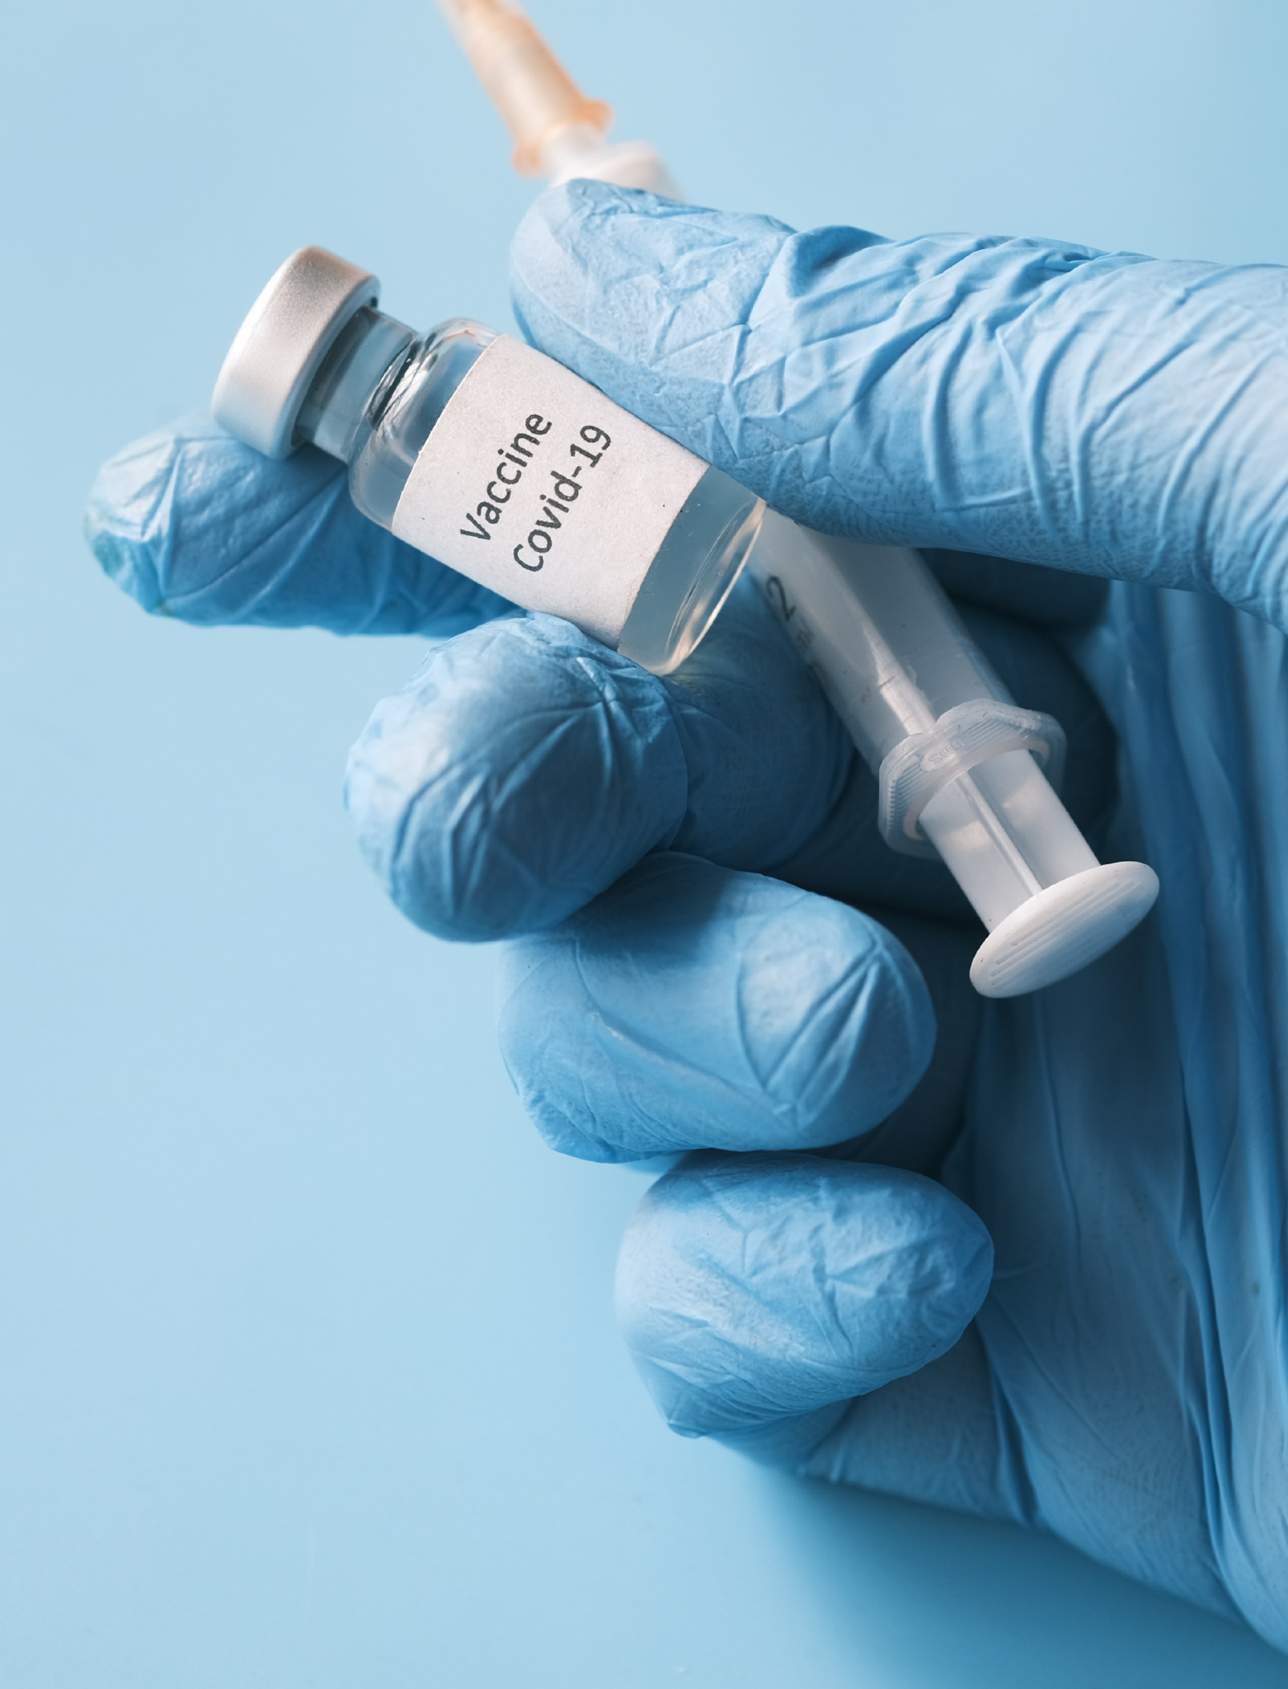
Dominex
INFO: 5100 : Application Engineering Development Project
Drug Management Application
Tarush Singh | Harshveen Kalsi | Ramit gupta

Slide 2
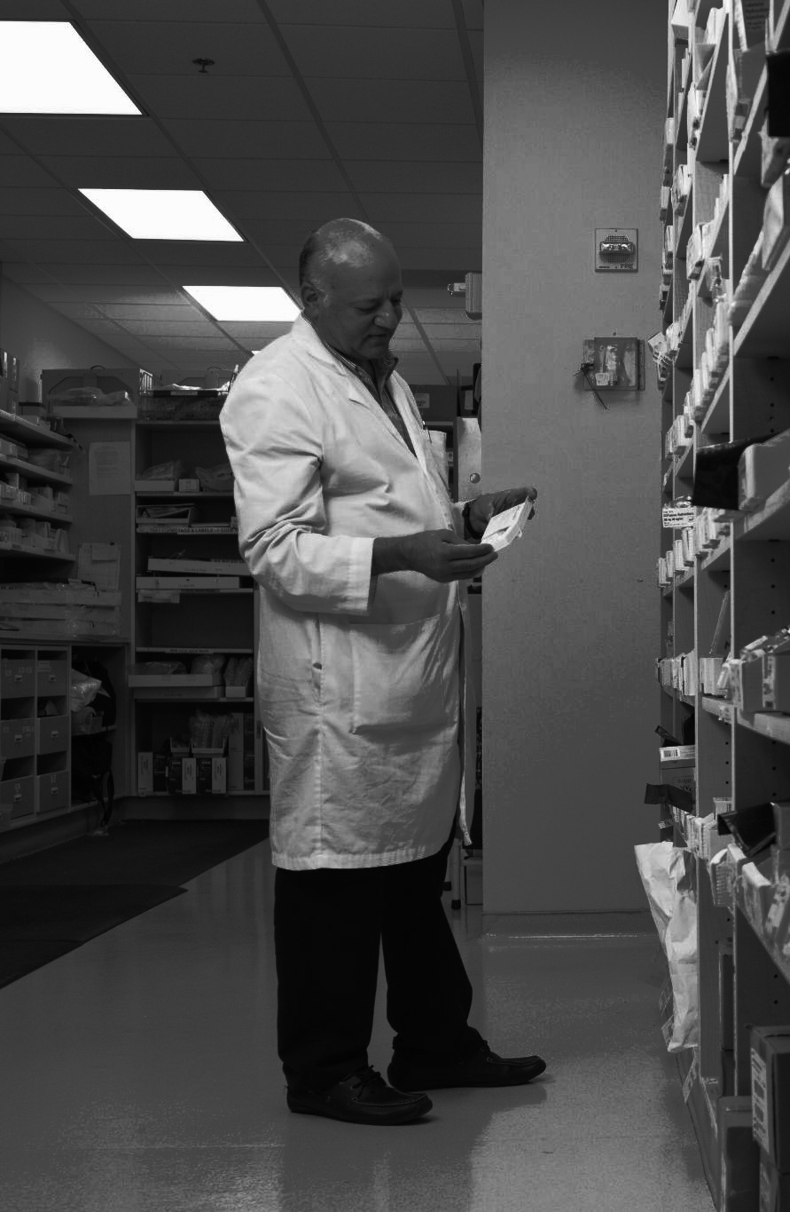
INDEX
Project Description
Application Structure
Purpose
TechStack
Domain Model
Implementation
Task Assignment
References

Slide 3
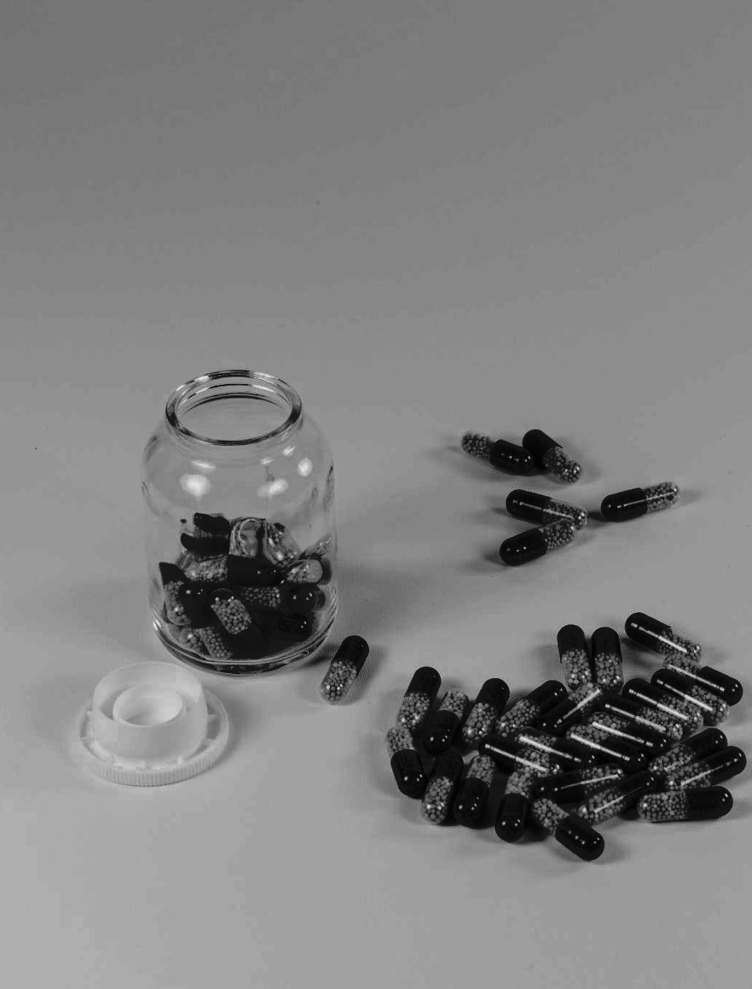
Overview
The drug development cycle is an extensive and complex yet important process in today’s world, where the probability of encountering new diseases is relatively high.
The goal of the whole process is for researchers to determine if a drug is safe and effective as a treatment for certain conditions.

Slide 4
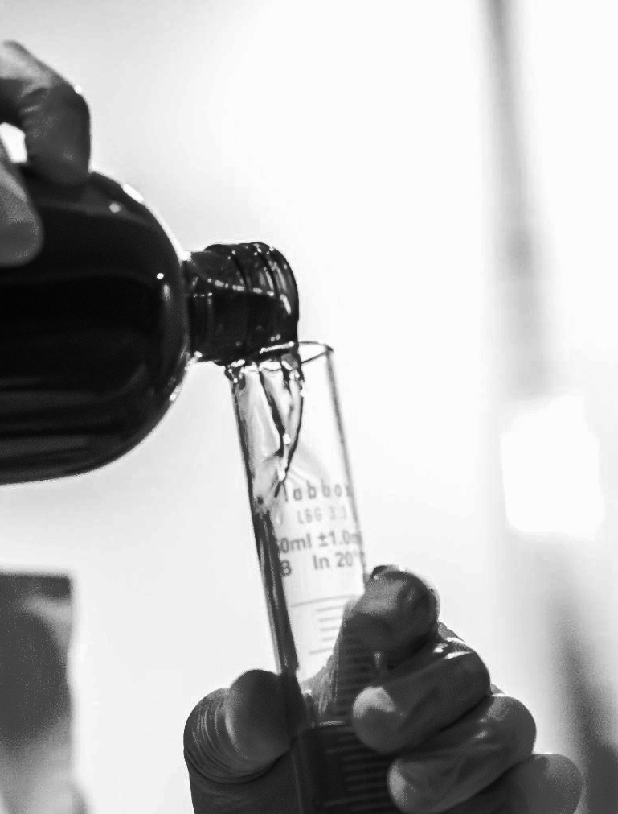
Project Description
This project replicates the real-world drug development cycle, right from the drug discovery phase to FDA approval and safety monitoring. It is a report generation application where, at every stage, there is proper monitoring of data and status visibility.
It’s hard for a big team of researchers working on a pharmaceutical drug to track their research progress in terms of different stages and get quality feedback from these stages.
Our application works as a solution for this problem

Slide 5
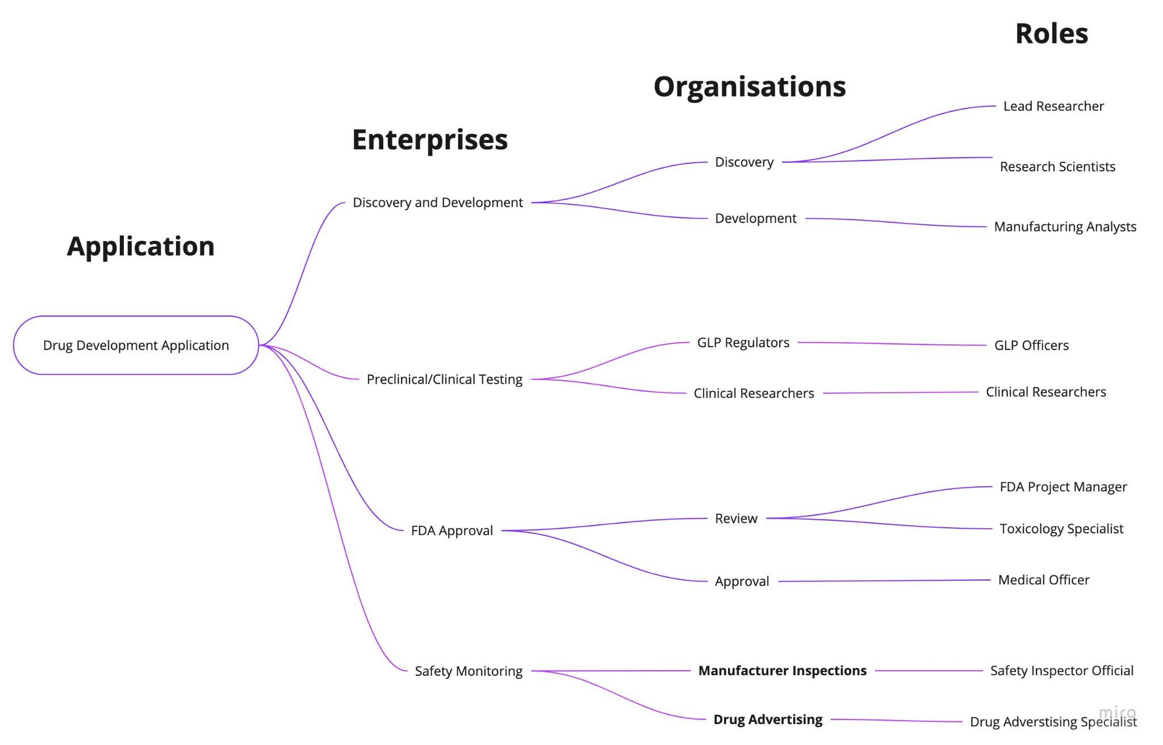
Application Structure
The application is structured in such a way that the four main pillars of the drug development process act as enterprises with multiple organizations, followed by various roles under them, each having their own individual responsibilities.

Slide 6
Enterprises, Organizations and Roles Breakdown
The different stages
Drug Discovery/Development - Clinical Testing - FDA Approval - Safety Monitoring
Enterprises
ORGANISATIONS
ROLES
Discovery/ Development
Testing
FDA Approval
Safety Monitoring
Discovery
Development
GLP Regulations
Clinical Researchers
Review
Approve
Manufacturer Inspections
Drug Advertising
Research Scientist
Research Lead
Manufacturing Analysts
GLP Officer
Clinical Researchers
Medical Officer
Toxicology Specialists
Safety Inspector
Advertising Specialists

Slide 7
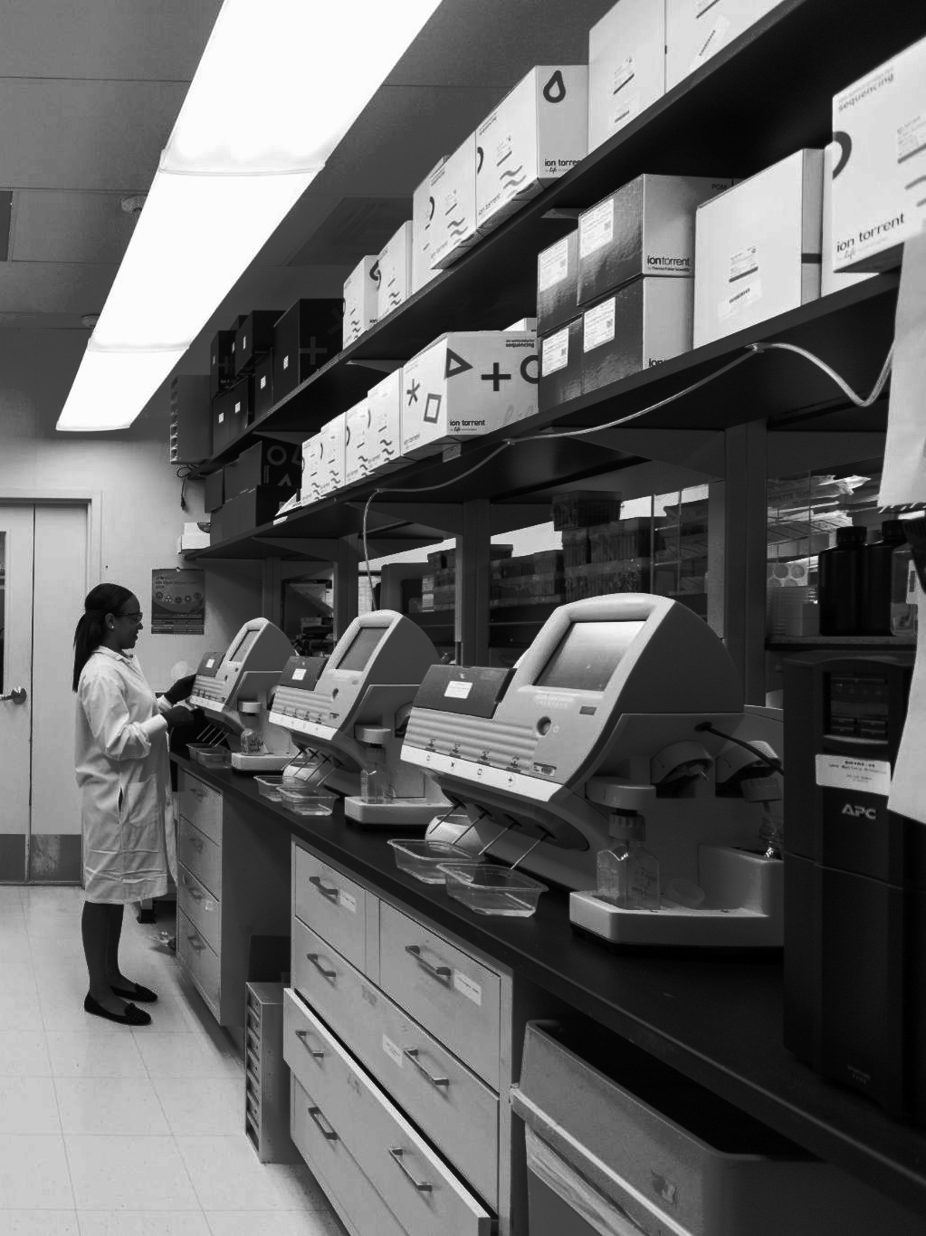
Services Provided
Stage Visibility: This application bridges the gap between the different stages in the drug cycle.
Feedback Mechanism: Allows user to understand developer and research feedbacks easily.
Clarity of Data: All the data collected from different stages is visible across enterprises and organizations
Our application assists researchers and developers in determining where the development is stuck and providing feedback based on that. Any organization from any enterprise can view this report and give their views on it. Different roles can update the report according to their research findings.

Slide 8

TechStack
Frontend - Swing
Backend - Java
Database - SQLite
IDE - Apache Netbeans

Slide 9
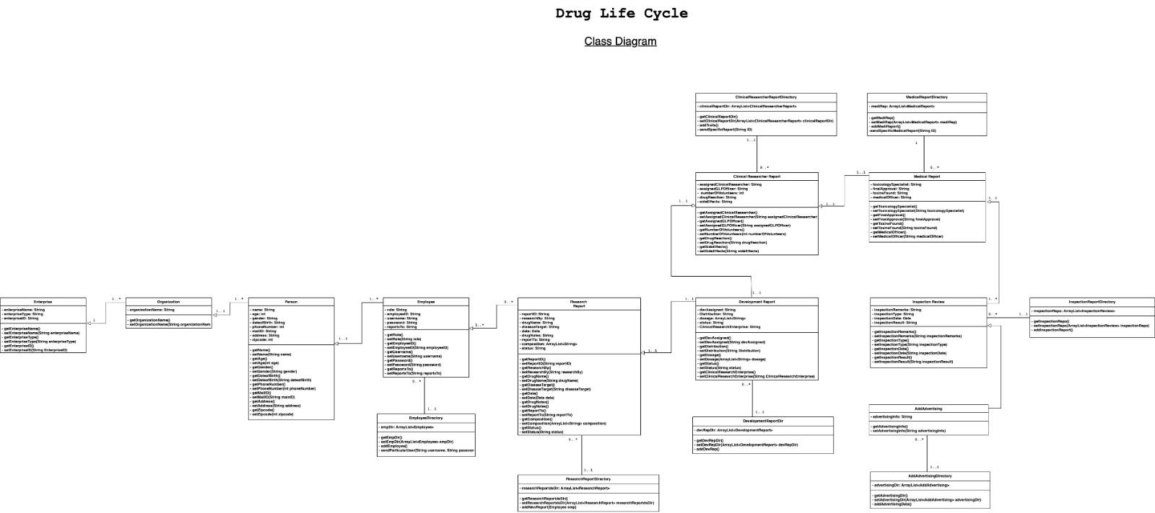
Domain Model: Class Diagram

Slide 10
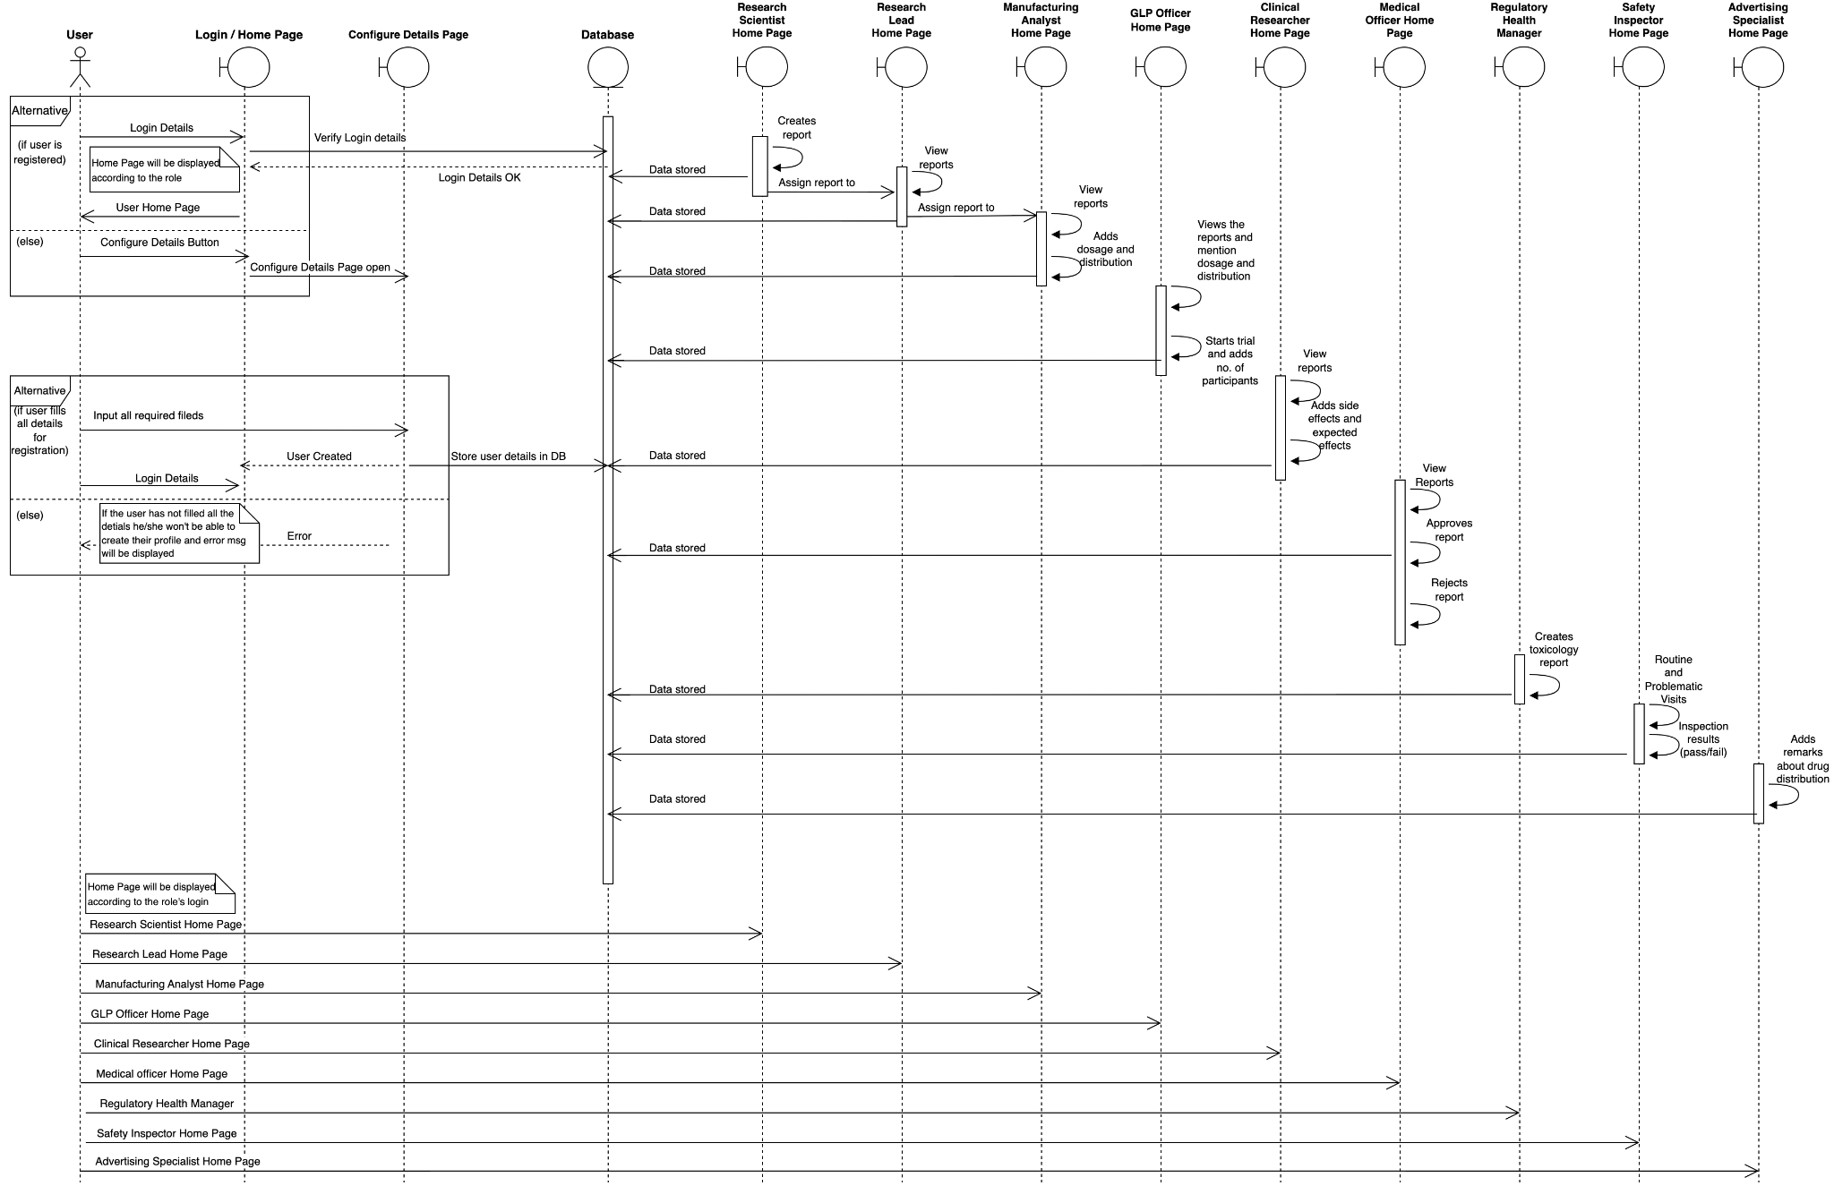
Domain Model:
Sequence Model

Slide 11
Implementation

Slide 12
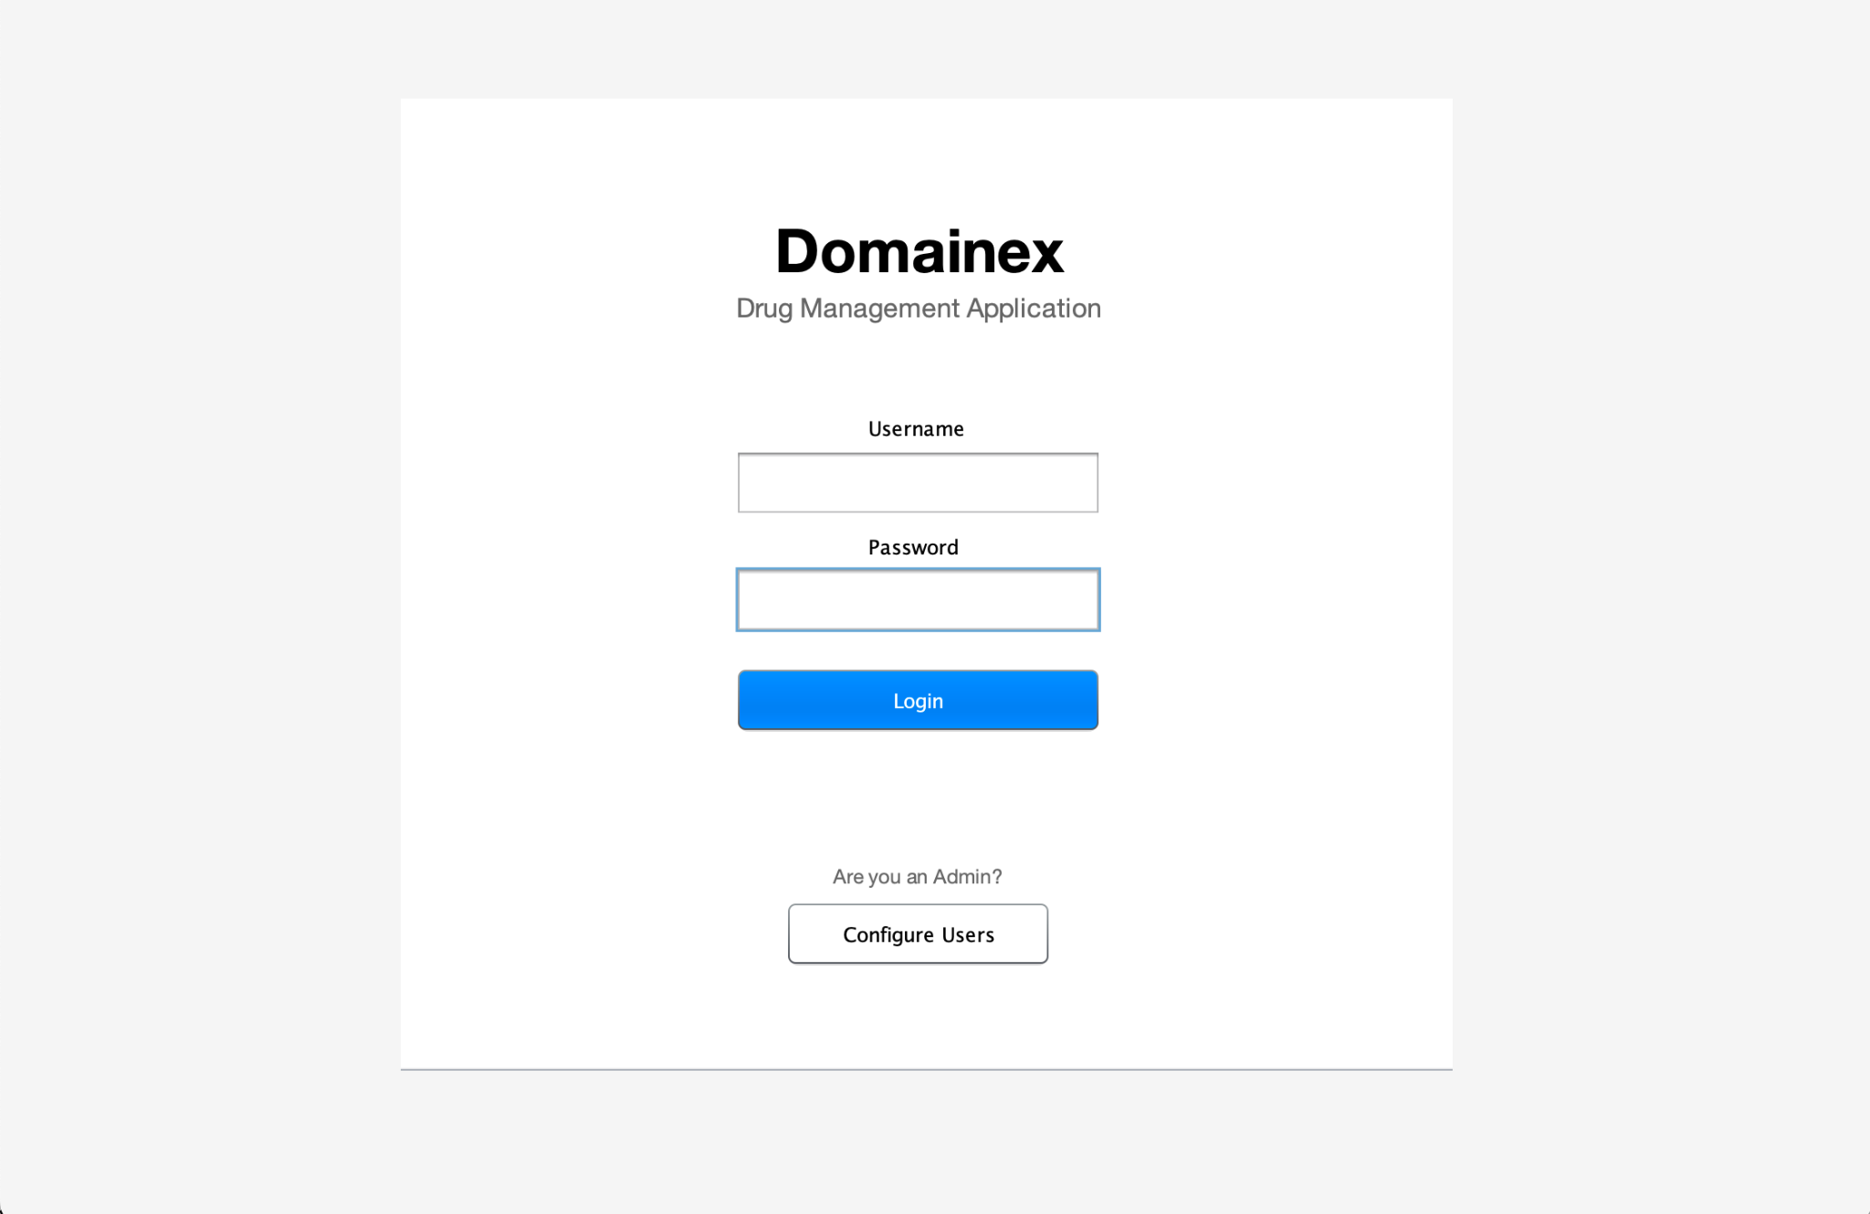
Login Page

Slide 13
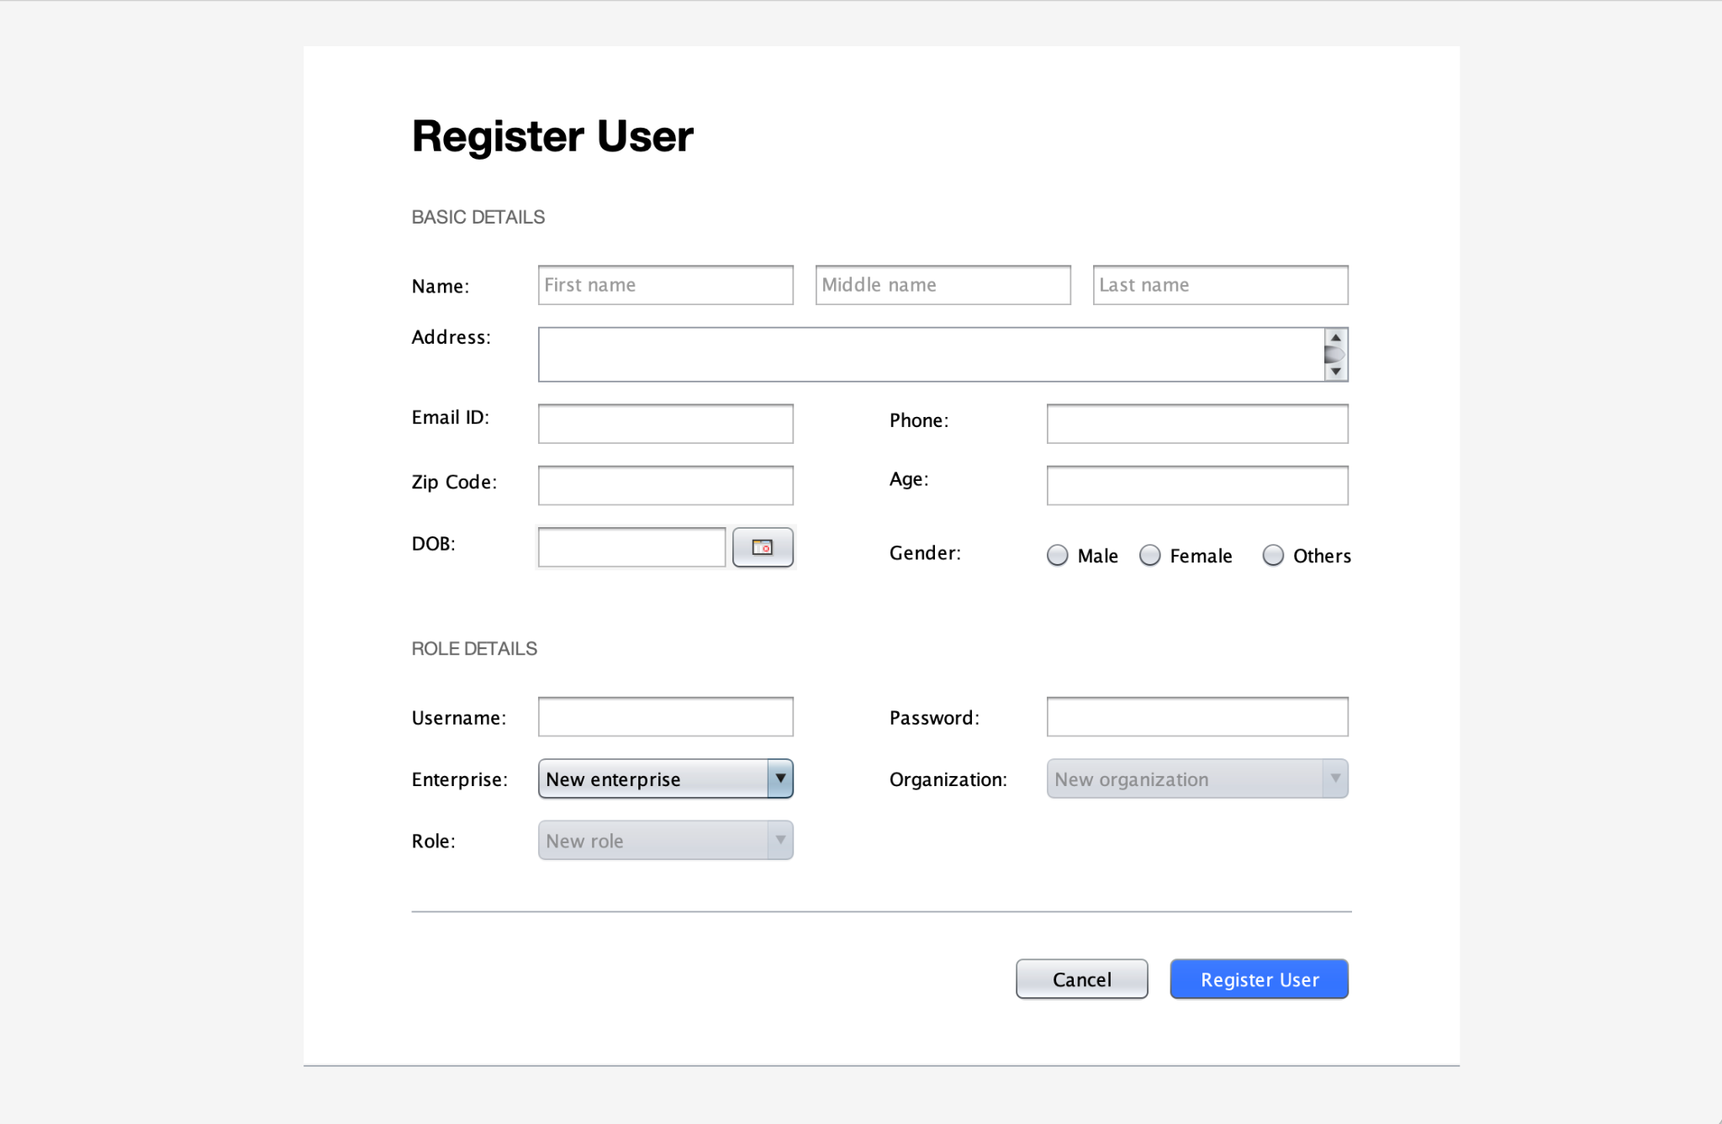
Adding New Role

Slide 14
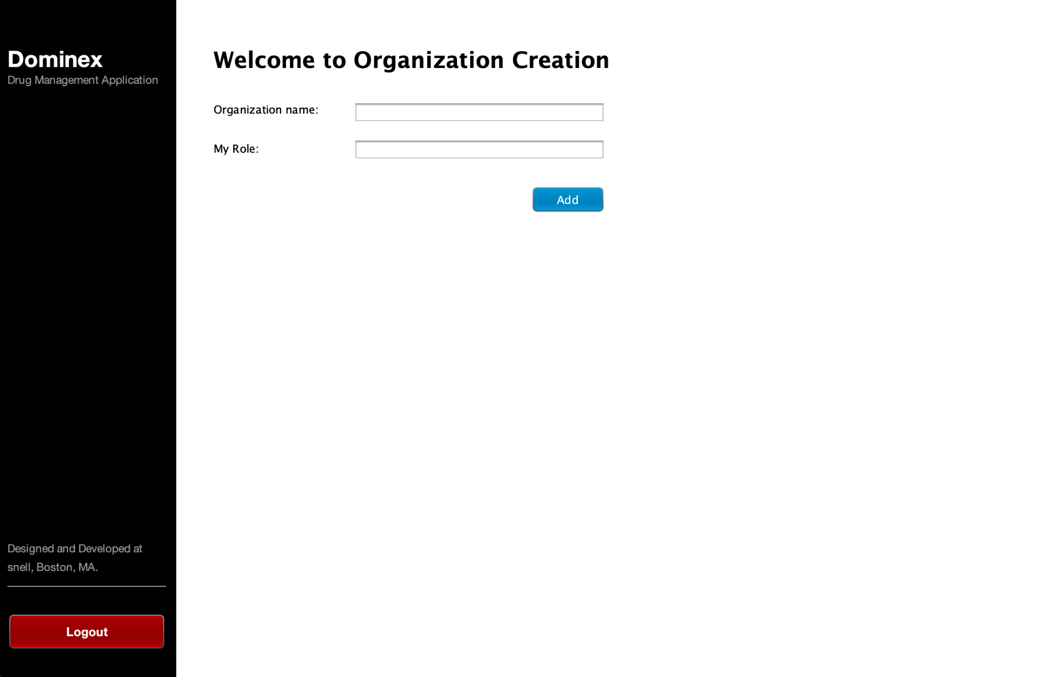
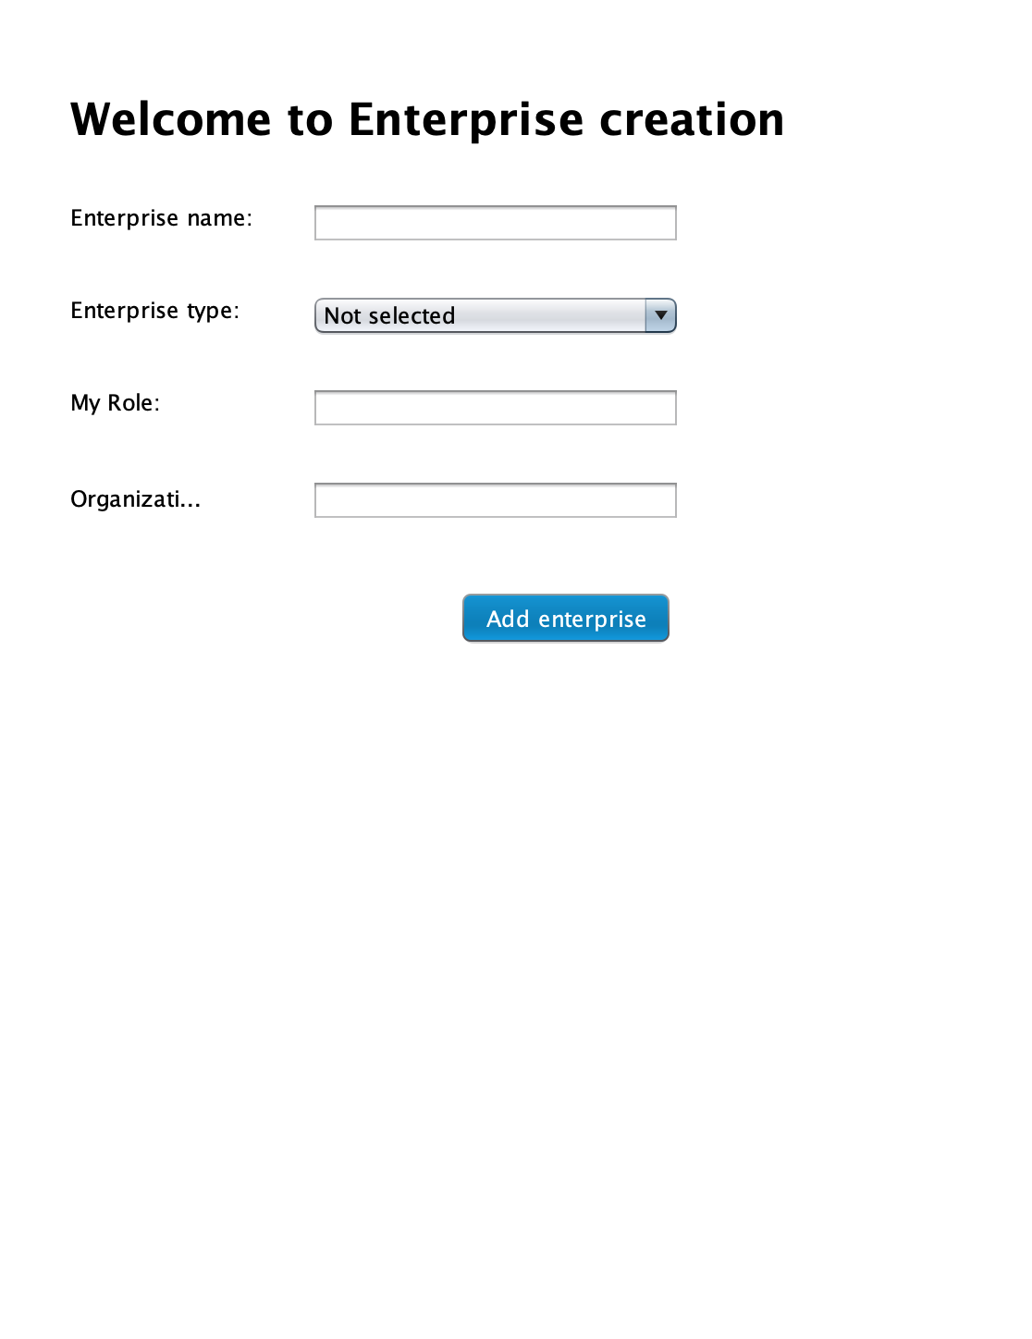
Adding New Enterprise

Slide 15
Adding New Organization

Slide 16
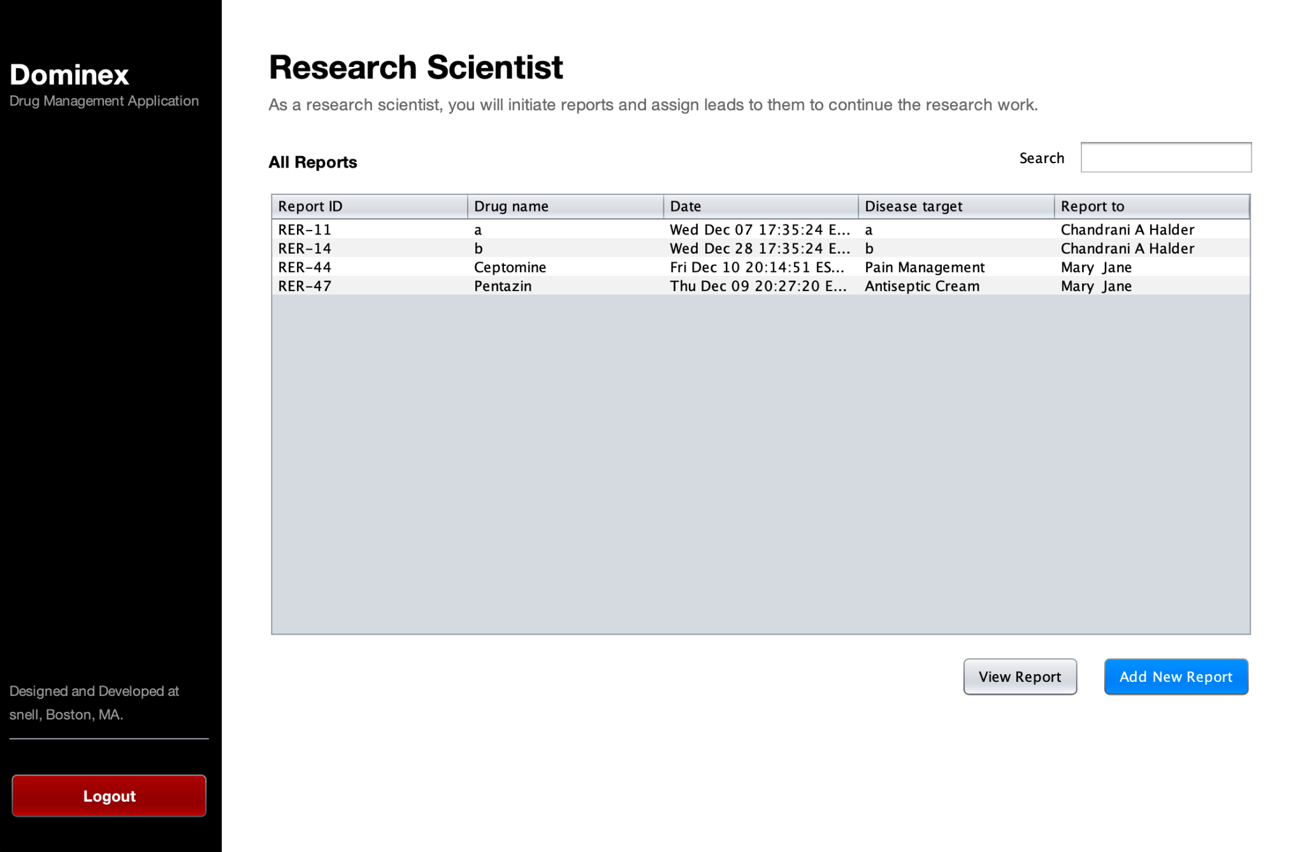
Research Scientist Home

Slide 17
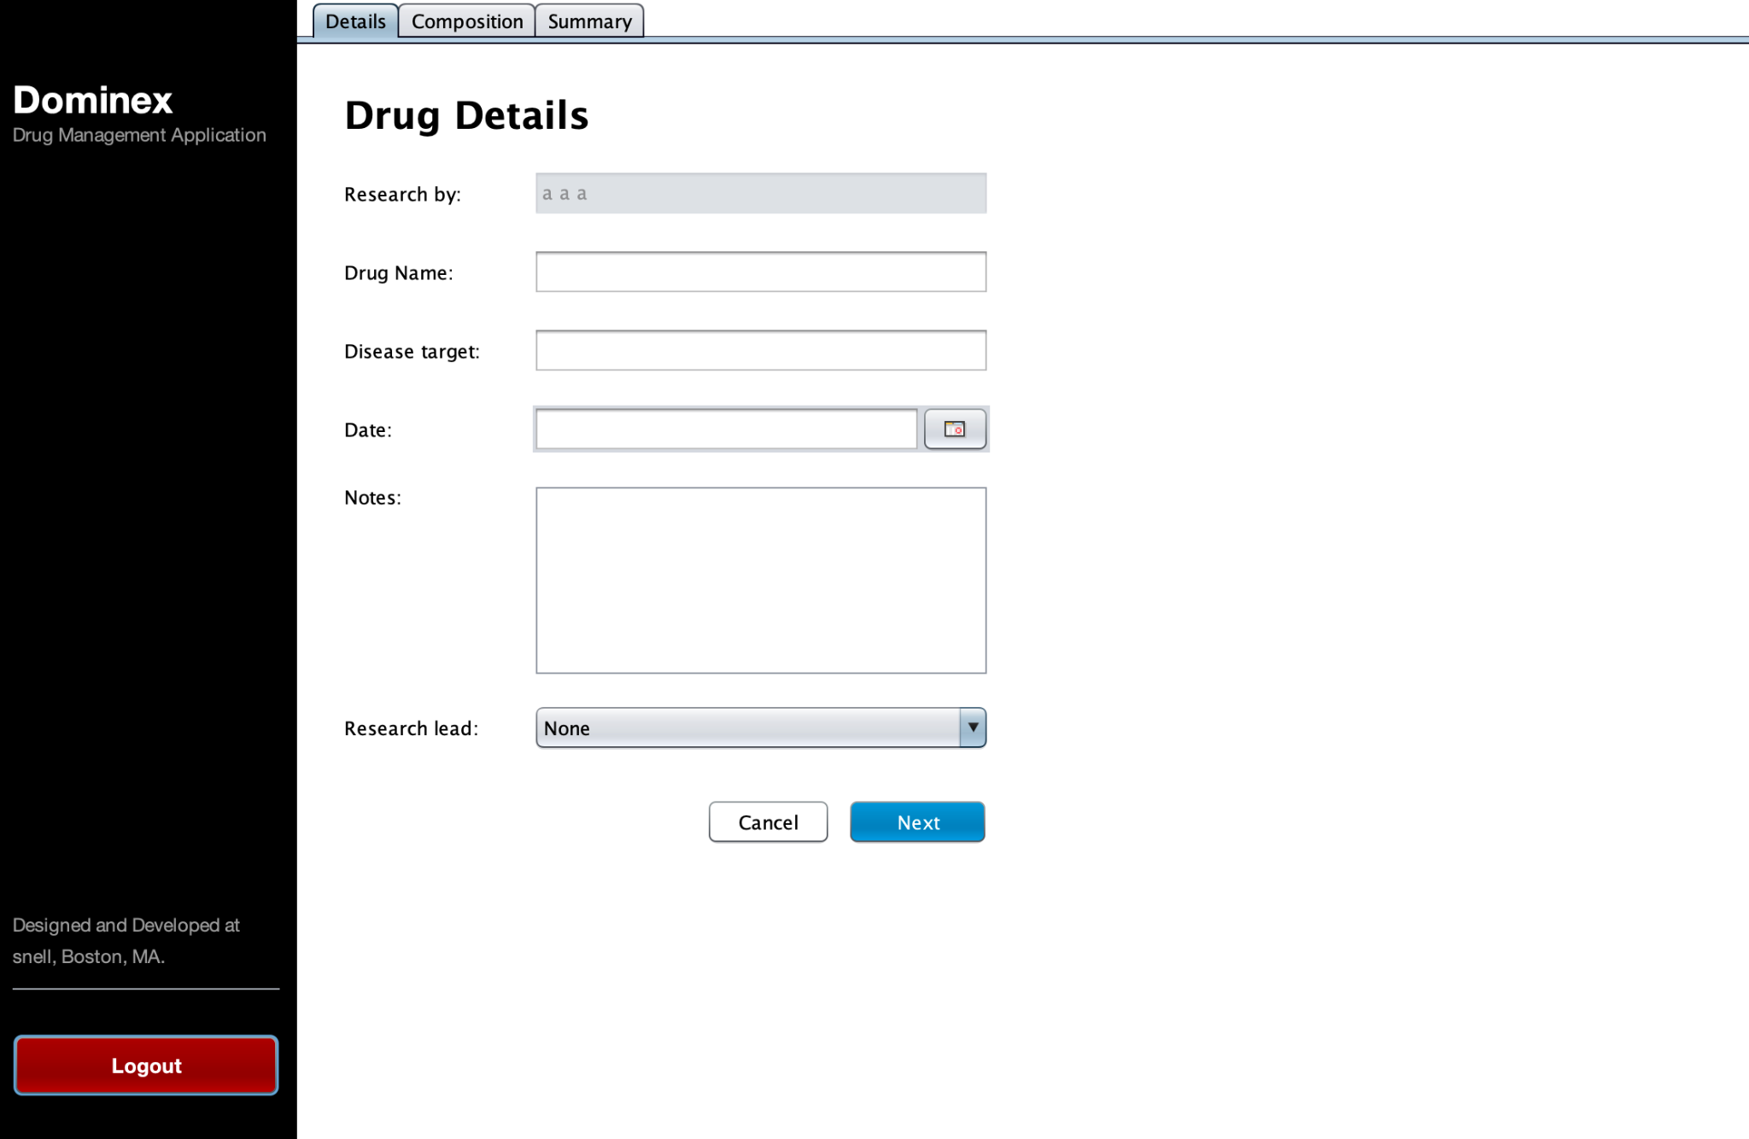
Research Scientist Creates the New Report

Slide 18
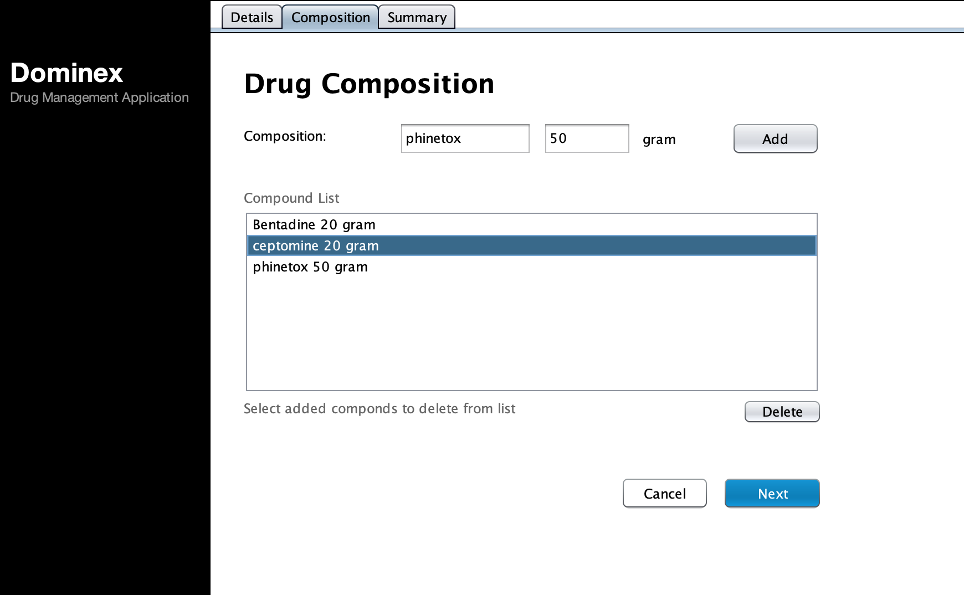
Compound can be added or deleted in the Drug Composition report.

Slide 19
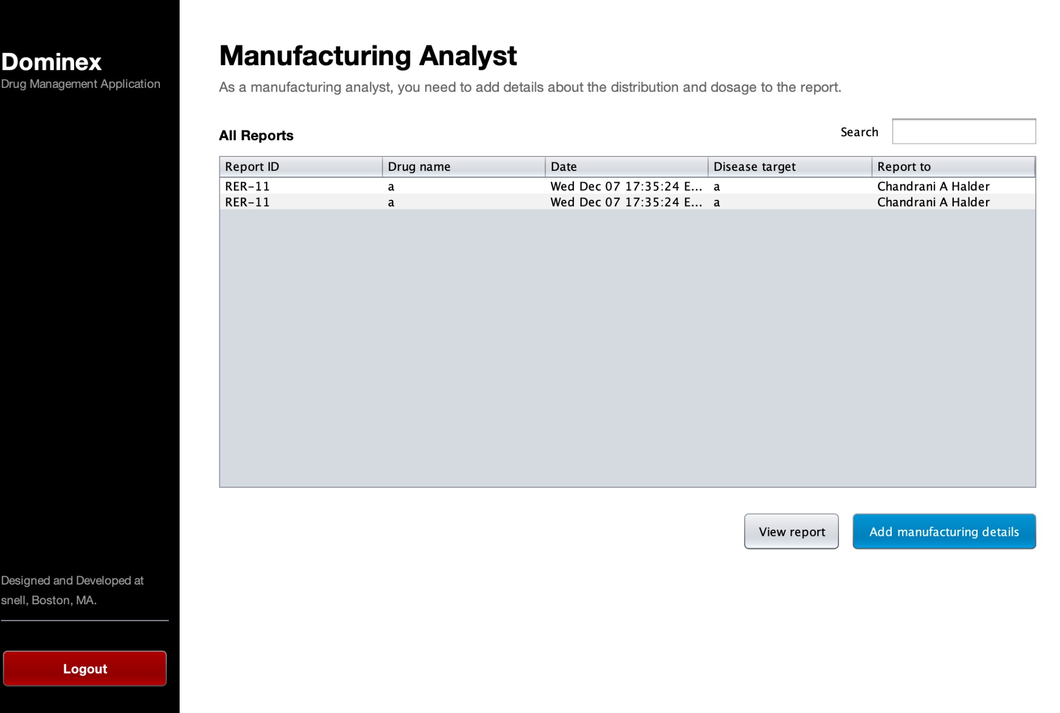
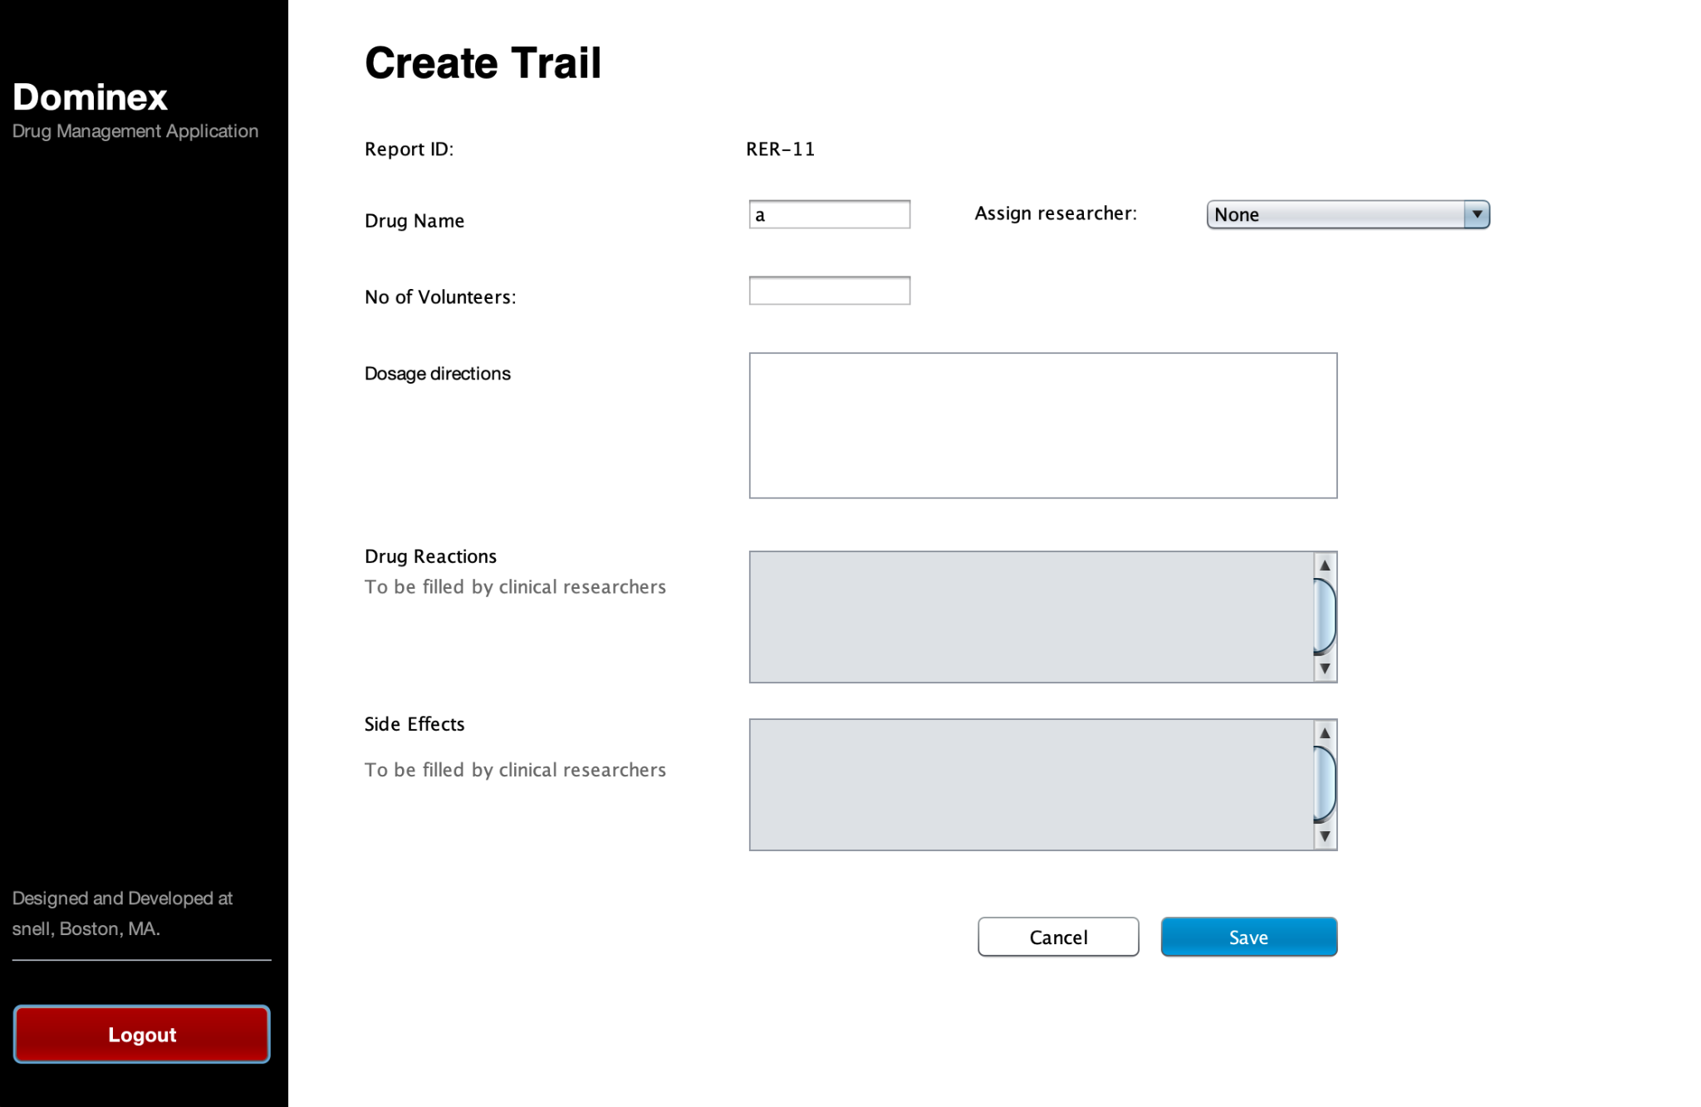
Manufacturing
Analyst Page

Slide 20
GLP Officer creating Clinical Trails.

Slide 21
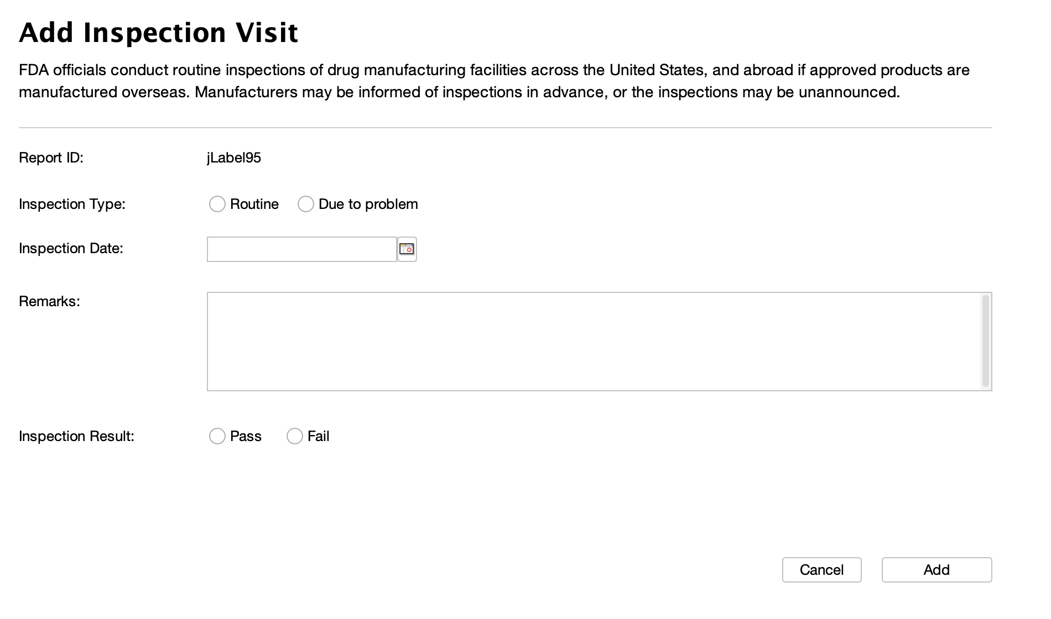
Inspection Officer adding visits

Slide 22
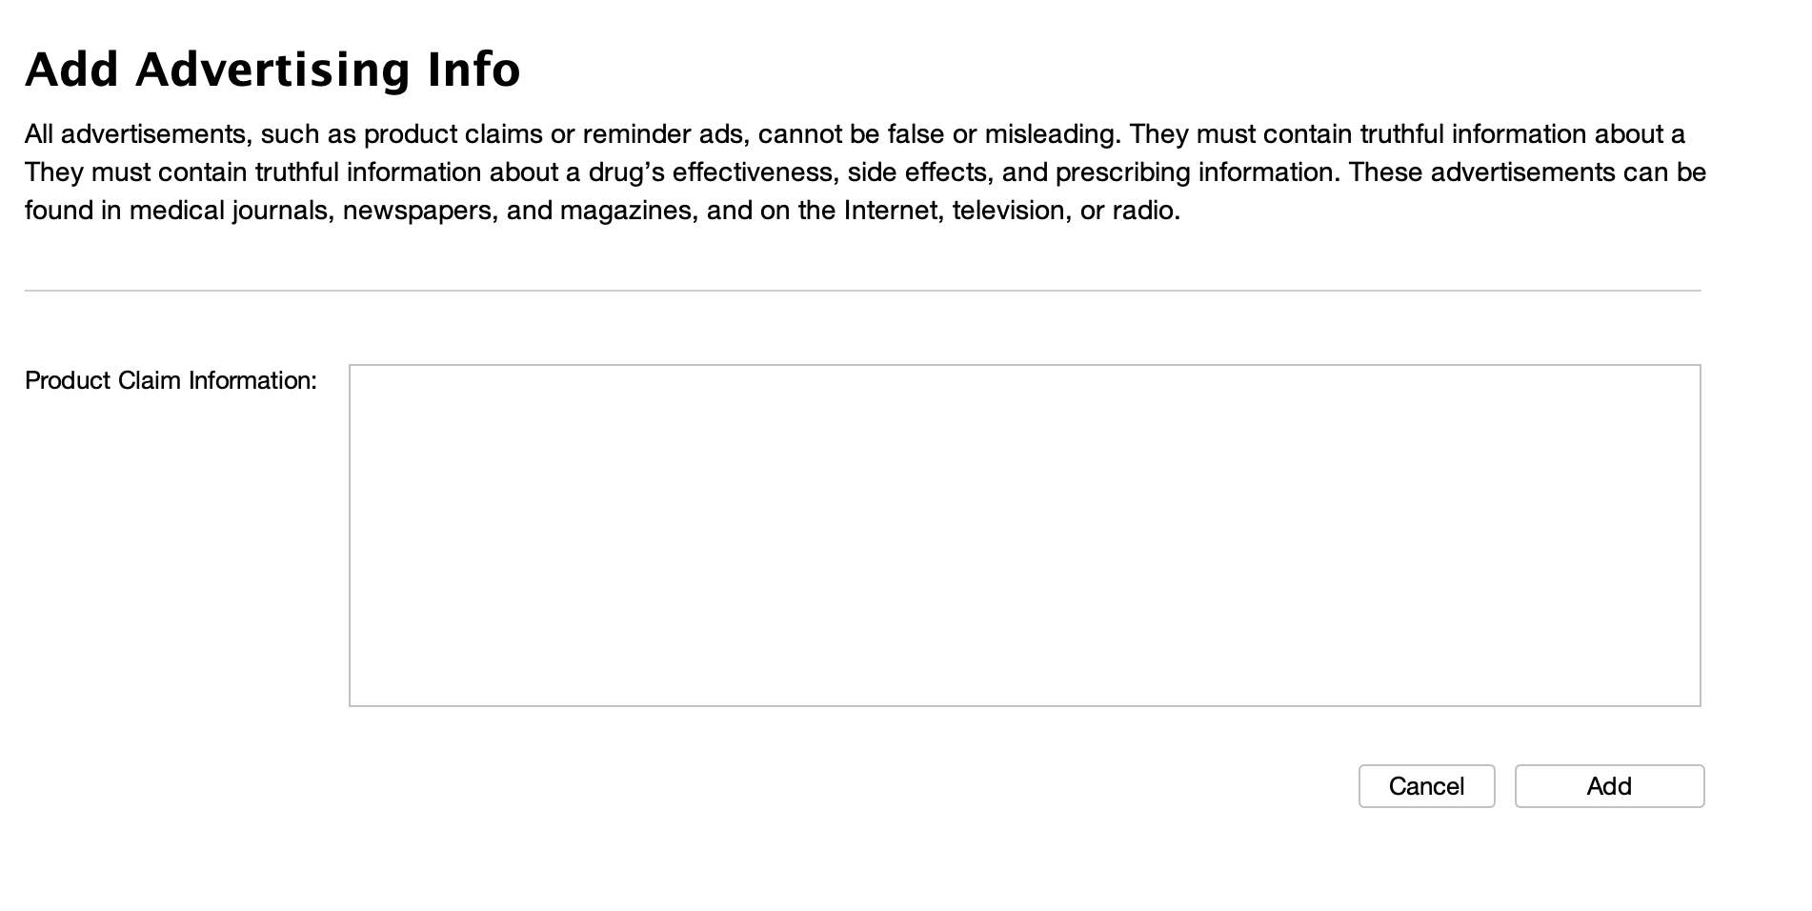
Advertising Officer giving details about Product Ad

Slide 23
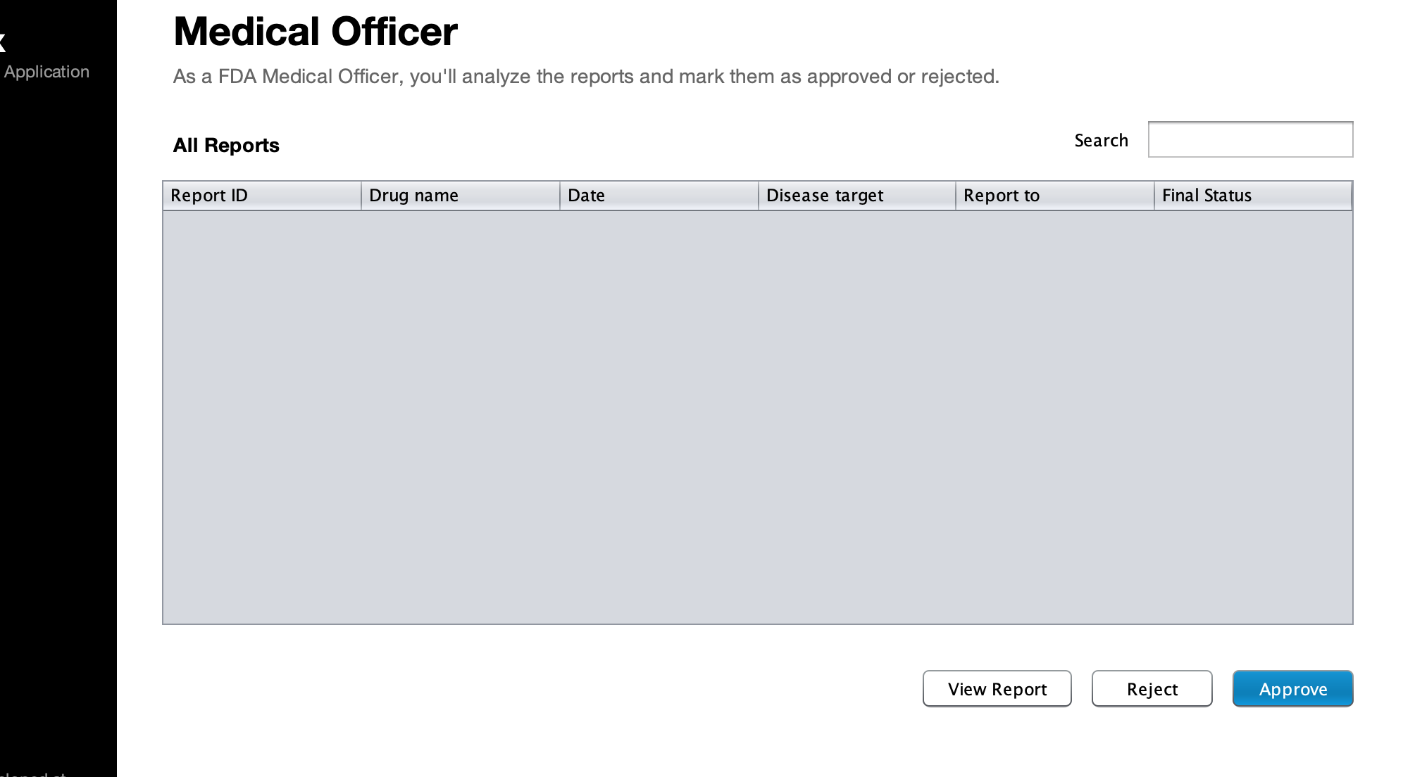
In the last step, FDA MEdical officer, can approve or reject the research report.

Slide 24
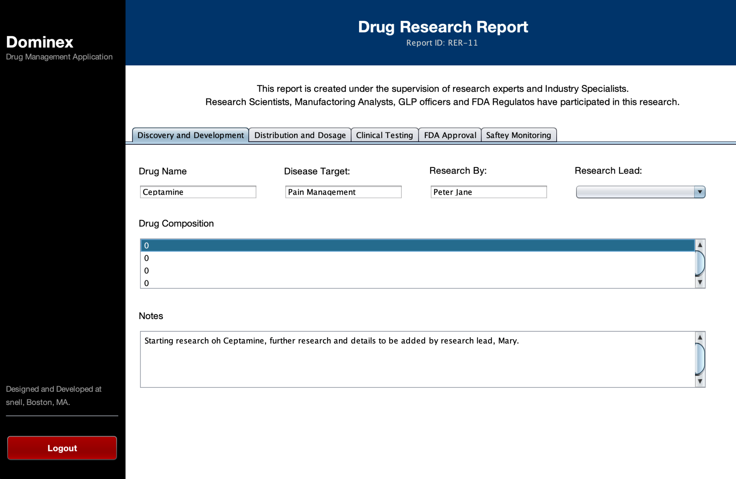
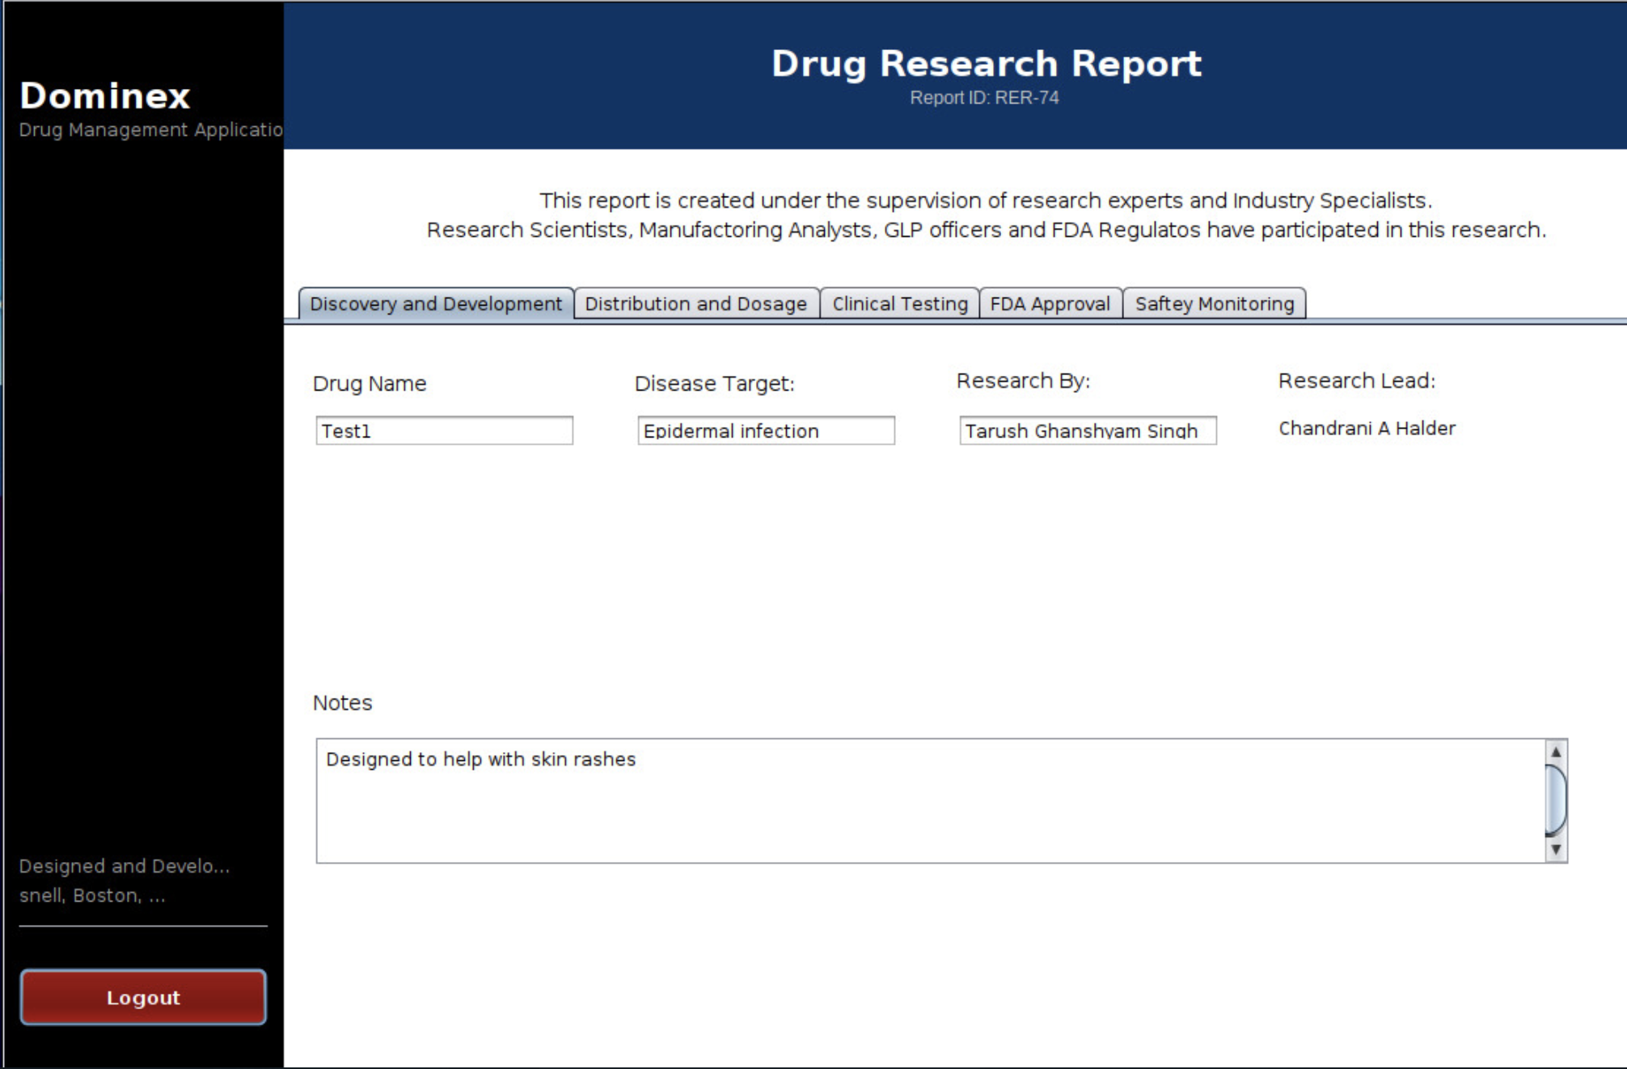
The Drug Report

Slide 25
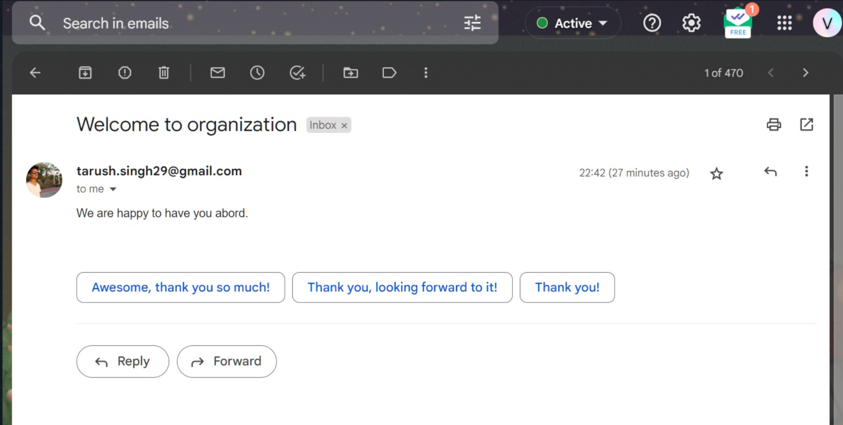
Additional Functionality
Email Confirmation

Slide 26
References
For this project, we spent the initial few days researching about the drug development cycle and familiarizing ourselves with the real-world terminologies so that we could use them in the application. Apart from the links mentioned below, we connected with a few research students to understand the process in depth.
https://www.fda.gov/patients/learn-about-drug-and-device-approvals/drug-development-process
https://www.wuxibiologics.com/drug-product-development/?creative=626218052540&keyword=drug%20product%20development&matchtype=p&network=g&device=c&gclid=Cj0KCQiAnNacBhDvARIsABnDa6_wxRUlgFwr9dEjRMbnmq0pUG6C7uzsHaFxI5GF1fZgeHbnZ82GcDgaAstqEALw_wcB
https://www.nebiolab.com/drug-discovery-and-development-process/

Slide 27
Thank You
INFO: 5100 : Application Engineering Development Project
Tarush Singh | Harshveen Kalsi | Ramit gupta

